Slide 1
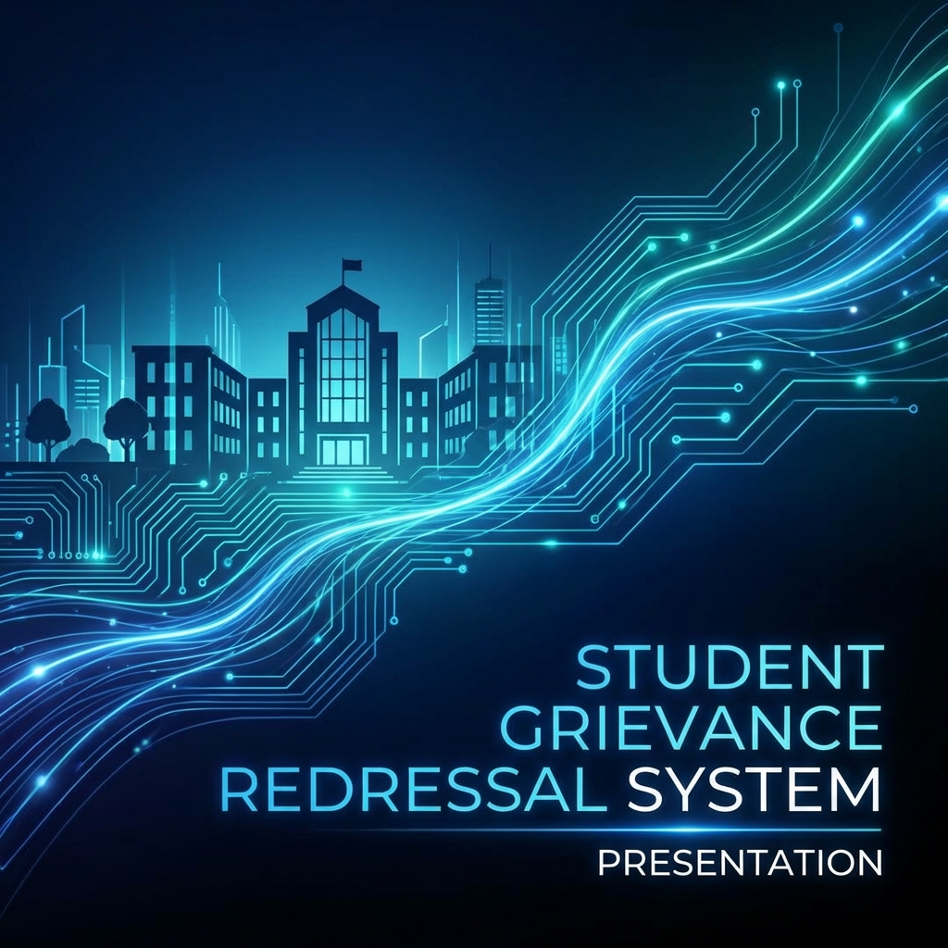
Student Grievance Redressal System
A Secure & Transparent Platform for Campus Voice
Final Year Project Presentation

Slide 2
Introduction
A digital bridge between students and administration.
Designed to streamline the process of reporting and resolving grievances.
Focuses on transparency, accountability, and efficiency.
Empowers students to voice concerns without fear (Anonymous options).

Slide 3
Problem Statement
Traditional systems are often manual and slow.
Lack of real-time tracking for students.
Potential for miscommunication or lost complaints.
Admin burden in managing paper trails.
No centralized repository for grievance history.

Slide 4
Objectives
Automate the grievance redressal lifecycle.
Provide a user-friendly dashboard for both students and admins.
Enable real-time status updates and notifications.
Ensure data security and student privacy.
Generate insights for long-term campus improvement.

Slide 5
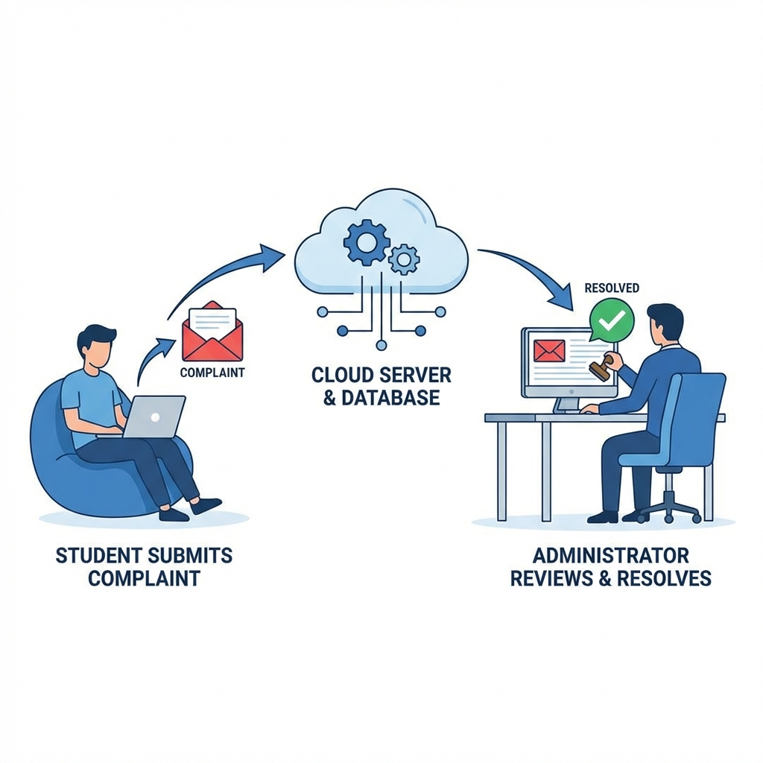
Project Architecture
Frontend: Responsive Glassmorphism UI (HTML/CSS/JS).
Backend: High-performance API using FastAPI (Python).
Database: Lightweight and efficient storage with SQLite.
Security: JWT (JSON Web Tokens) for authentication.
Architecture: RESTful API design.

Slide 6

Technology Stack
FastAPI: Modern, fast (high-performance) framework for building APIs.
SQLite + SQLAlchemy: Robust database and ORM for data integrity.
Glassmorphism UI: Trendy, professional, and responsive design.
python-jose/passlib: Industry-standard security and hashing.

Slide 7
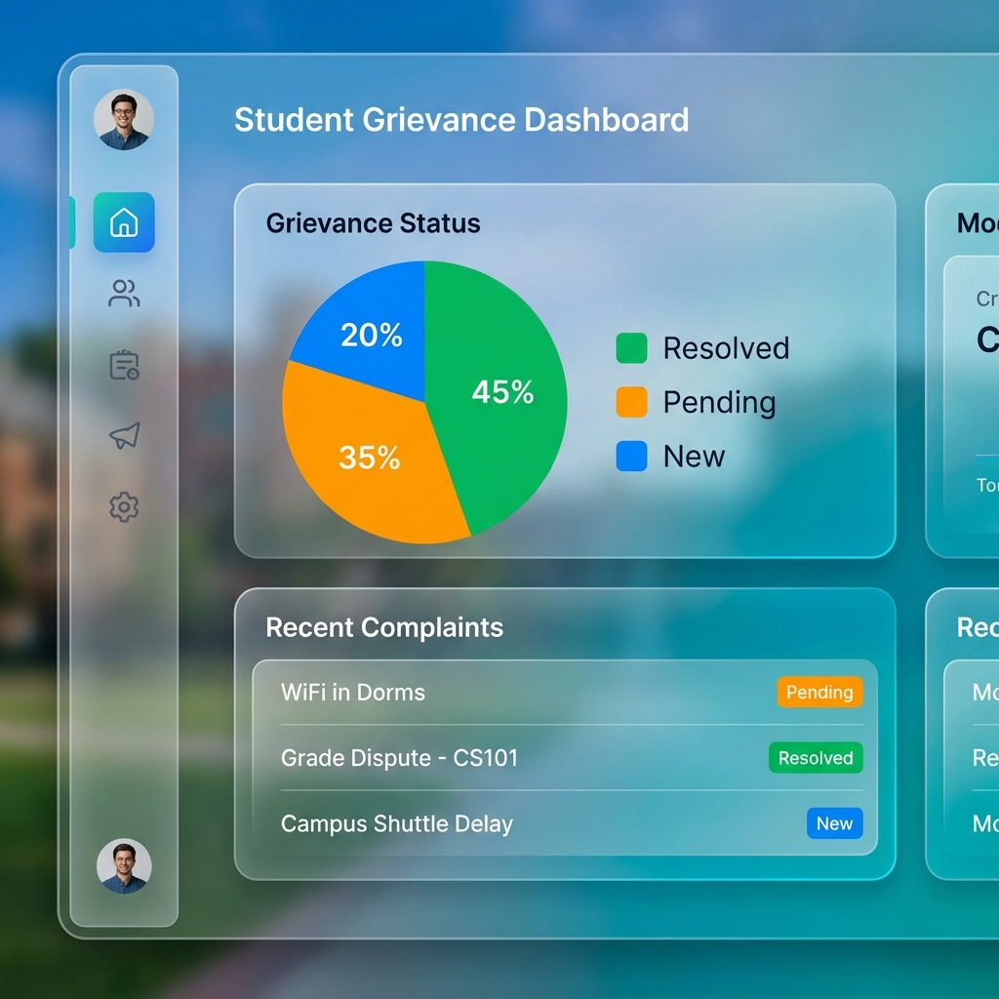
Student Features - Onboarding
Secure Registration: Input name, email, and password.
Dashboard: At-a-glance view of active and past grievances.
Profile Management: Maintaining personal details.
Role-based Access: Ensures students only see their own data.

Slide 8
Student Features - Submission
Smart Categorization: Selecting the right department (Academic, Hostel, etc.).
Detailed Description: Contextual input for clarity.
Anonymous Mode: Option to report without revealing identity.
Instant Submission: Immediate logging into the system.

Slide 9
Student Features - Tracking
Real-time Status: Pending, In Progress, or Resolved.
Admin Remarks: Viewing feedback from the resolution team.
Timeline View: Chronological history of the grievance.
Search & Filter: Easily locate specific complaints.

Slide 10
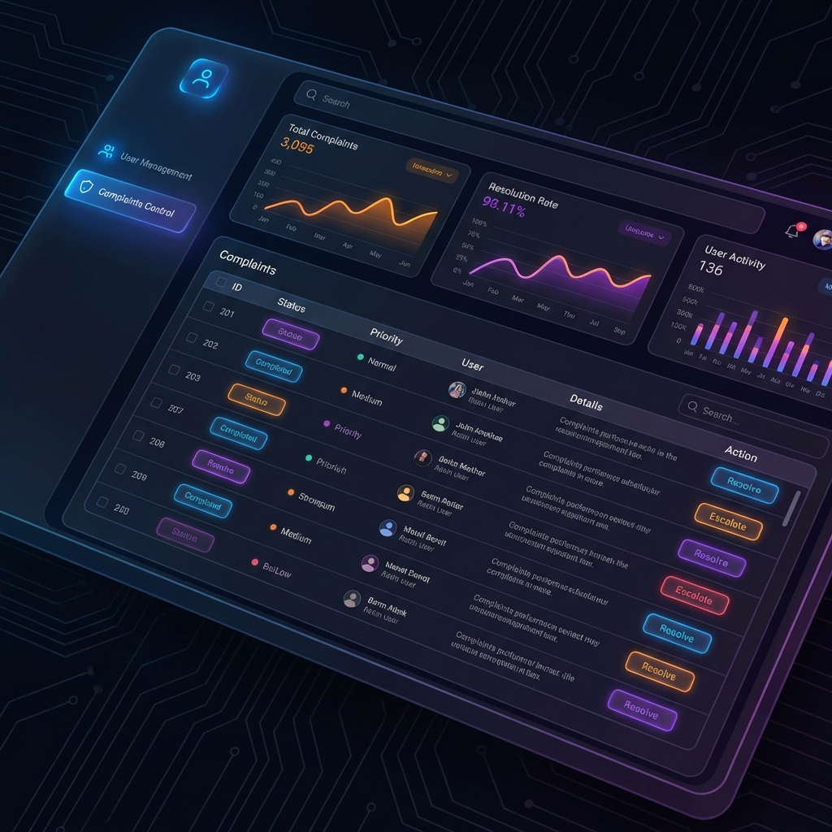
Admin Features - Overview
Unified Dashboard: Bird's-eye view of all complaints.
Statistics: Monitoring total, pending, and resolved cases.
System Monitoring: Ensuring the platform is healthy.
Secure Login: Dedicated portal for administrators.

Slide 11
Admin Features - Management
Actionable List: Direct access to student grievances.
Status Control: Updating progress (e.g., 'In Progress').
Remarking System: Providing official responses/decisions.
Accountability: Records of who resolved which complaint.

Slide 12
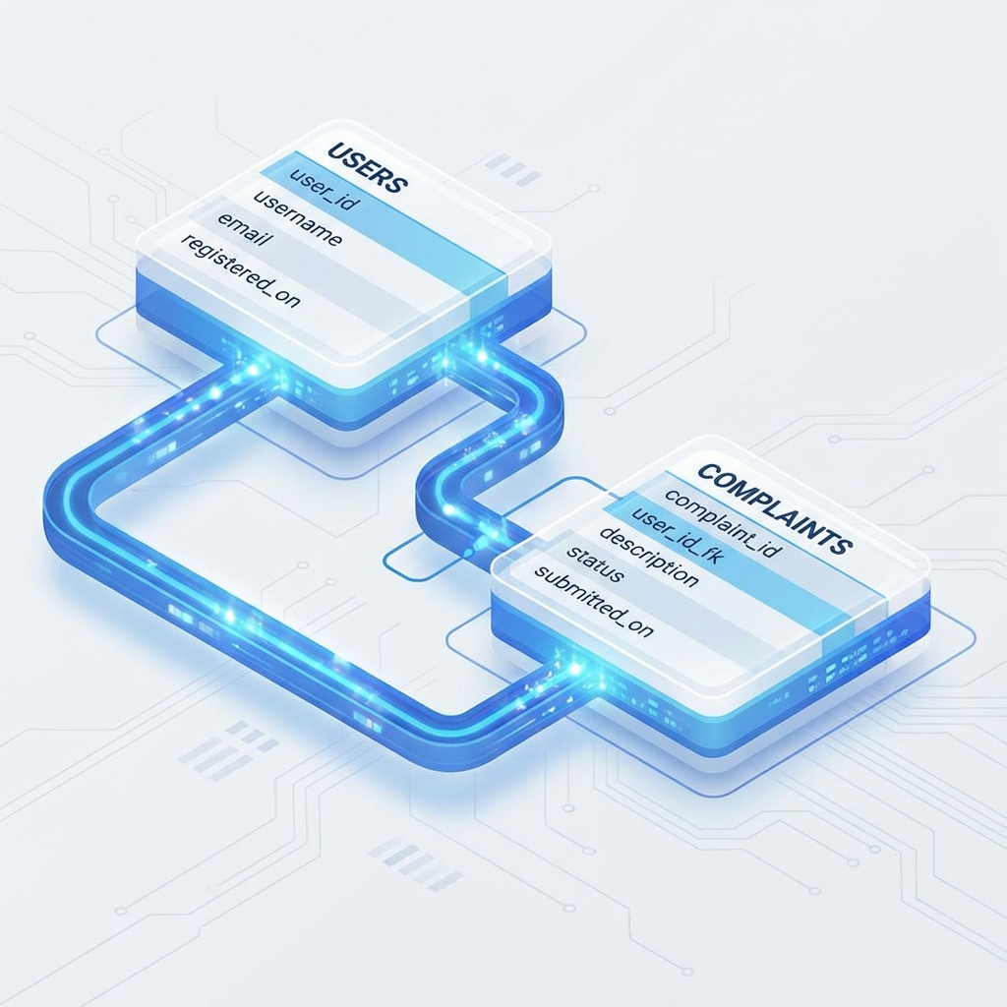
Database Schema
Users Table: Stores id, name, email, hashed_password, and role.
Complaints Table: Links to users, category, description, status, and remarks.
Relationships: One-to-Many (One student can have multiple complaints).
Data Integrity: Cascading deletes and foreign key constraints.

Slide 13

Security & Authentication
Password Hashing: Using Argon2/Bcrypt for data protection.
JWT Authentication: Secure communication between Frontend and Backend.
CORS Middleware: Controlled access to API endpoints.
Environment Control: Managed configurations through .env.

Slide 14
Design Philosophy
Visual Excellence: Glassmorphism effects for a premium feel.
Responsive Design: Full functionality on mobile, tablet, and desktop.
Accessibility: High contrast and clear typography (Outfit/Roboto).
Simplicity: Guided user flows to reduce cognitive load.

Slide 15

Conclusion & Future Scope
Successfully delivered a modern solution for campus grievances.
Future Scope: AI-driven complaint classification.
Future Scope: Mobile Application (iOS/Android).
Future Scope: Integration with University ERP systems.
Future Scope: Multi-level administrative approval workflow.

